Slide 1
Hacking Attacks against Government Institutions
Vassil Velichkov
30+ Years in the Trenches – Reality is often stranger than Fiction

Slide 2
Agenda
Meet the Government – Get the Context
01
Real-World Examples of Sheer Stupidity
02
Real-World Examples of Gross Negligence
03
Real-World Examples of Hacking Attacks
04
Final Thoughts & Conclusions
05
Q&A
Notes:
Quickly go through the Agenda to let the person/people in the meeting know what they should expect (think if we should change the names of the points?)

Slide 3

How big the Government is? What about the Public Sector?
01-1
Legal Entities in the Public Sector
14 000+
Administrative Structures
Executive Branch
708
Administrative Structures
Judiciary Branch
301
Notes:
Cover the points clockwise starting with the number of years of experience
So what brought us here and helped us discover our mission?
It all started back in 2012 when Sensika was established after its founders identified a market gap and figured a way to disrupt the media monitoring industry. (give more details how we are different)
When Sensika was introduced to the market it was a revolutionary solution that used automation and technology to achieve highest-precision insights and a 360 degrees coverage of all of the available media channels – maybe this needs to be rephrased?
Gradually we expanded our portfolio of services and coverage, reaching the unmatched coverage of 120+ languages and 190+ countries and territories
Throughout the years we had the chance to work with some of the most demanding organizations worldwide and served more than 200 organizations and brand…

Slide 4

It’s the People, Stupid…
01-2
…at least until GPT-XX takes over…
Stupidity
Negligence
Incompetence
Corruption
Special Interests
Sabotage & Revenge
Two things are infinite:
The universe and human stupidity; and I'm not sure about the universe.
Albert Einstein
Coleen @trillxART ©
Notes:
Sensika is most proud of the bespoke approach that we deliver to our clients, achieved thanks to the constant efforts of our dedicated team
We truly believe in the immense potential of Human Intelligence, especially when it is supported by state-of-the-art technology and AI
Therefore, we have adopted an innovative (Human-in-the-loop) HITL approach, characterized with the injection of Human Intelligence on every step of our processes, broken down to 3 main steps:
Technical experts are involved in the process of content harvesting and in the maintenance of our Coverage Catalogue. Our Coverage Catalogue is automatically enriched every minute, however, injecting human expertise in that process allows us to ensure that the needs of our clients are met with utmost priority
Combine Step 2 and 3 as there is some overlap and it would be smoother → When it come to the quality of the analysis and the insights that we deliver, Sensika is the undoubtful leader on the global market. As previously mentioned this is achieved due to the unique combination of technology, Human and Artificial Intelligence. Our domain experts apply their knowledge and experience in media monitoring and analysis to help you answer all of your questions on your own or through a complete/comprehensive media monitoring report customized for your needs.

Slide 5
Real-World Examples of Sheer Stupidity

Slide 6

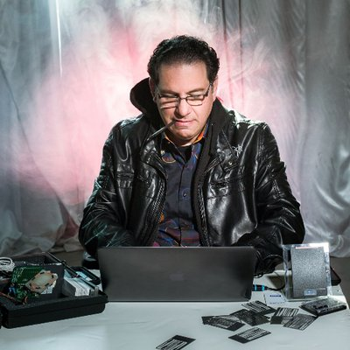
Default User Names & Passwords for New Users
02-1
What:
Sustainable Practice
Initials + Digits
Where:
Council of Ministers
When:
Observed between 2010 and 2022
Actions Taken:
Terminated, Disciplinary Measures
Current Status:
Unknown (most probably reinstated)
Kevin Mitnick
Former Hacker
Who Never Hacked
Plamen Oresharski
Former Bulgarian PM
Who Never Governed

Slide 7
Real-World Examples of Gross Negligence

Slide 8

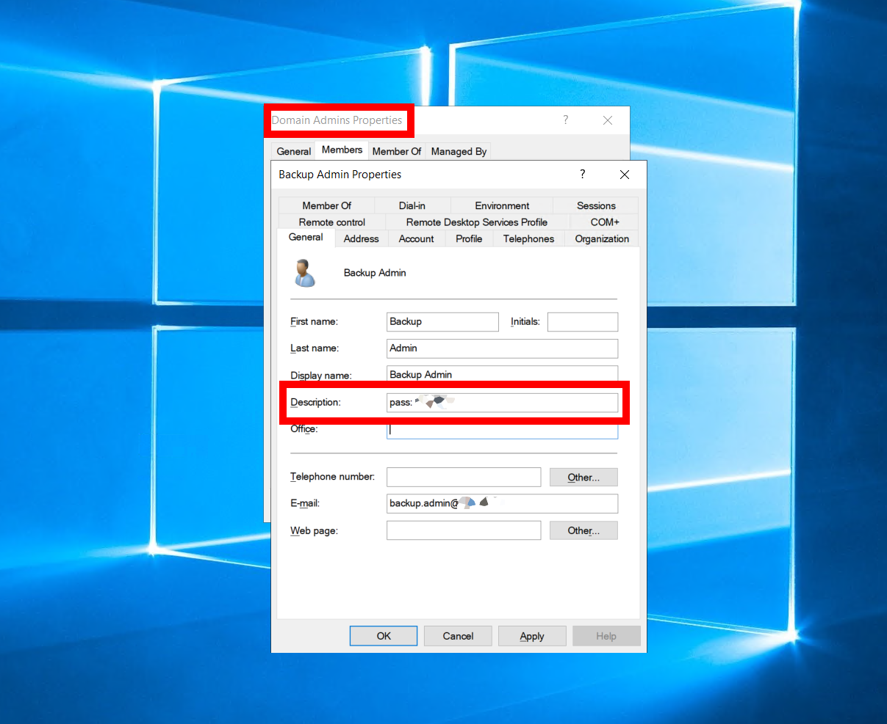
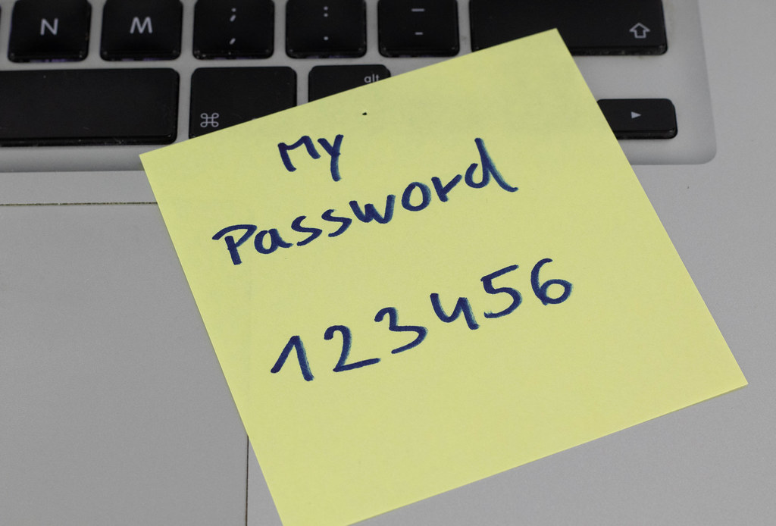
Keys for Grab – a SECURIT ™ Glass Away…
03-1
AD Authenticated users can read AD Description attribute
RDP is handy…
What could possibly go wrong?
Cliché
or
Not?
Domain Admin User with password saved in AD Description attribute
TCP port 3389 open with Firewall Exception Rule

Slide 9

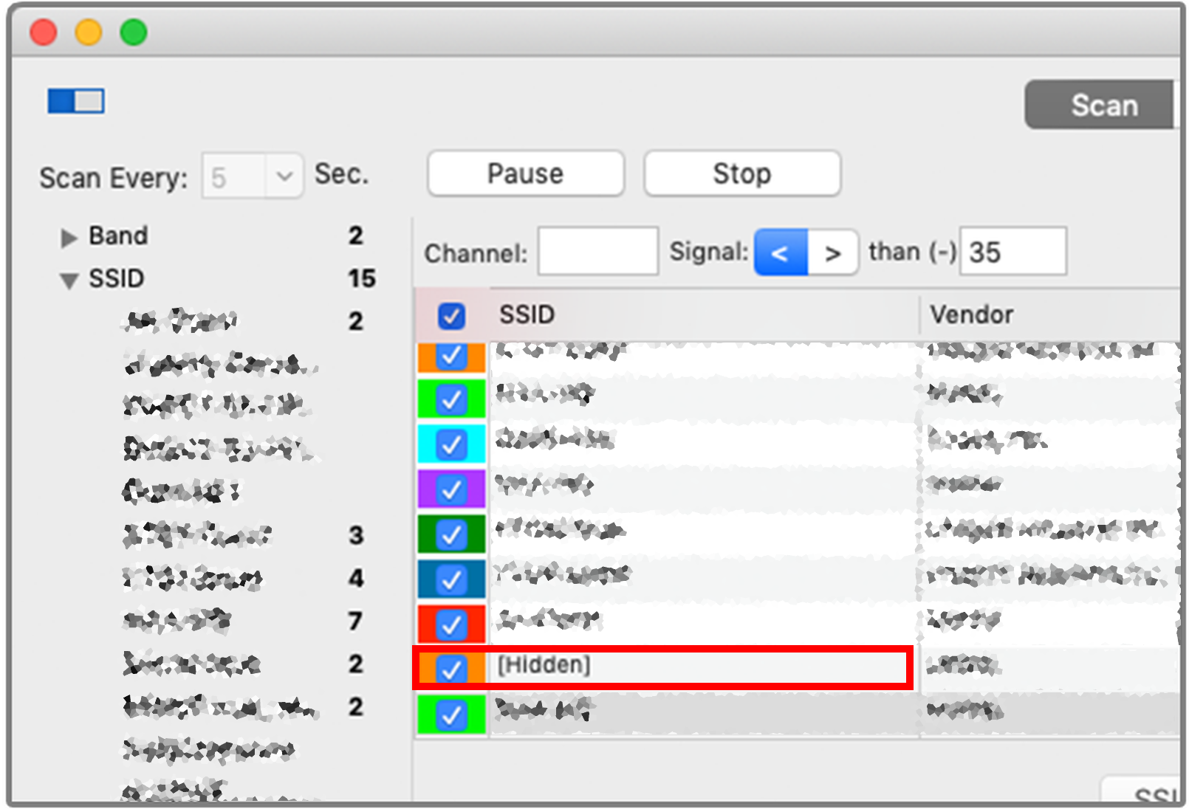

Door in the Field – You are Welcome, Anytime…
03-2
No VLAN segmentation…
PCs & Servers not patched for ages…
Negligence or Malicious Intent?
Cliché
or
Not?
Hidden WiFi SSID
2.4GHz, WPA-PSK
40+% signal across the street

Slide 10
Real-World Examples of Hacking Attacks

Slide 11
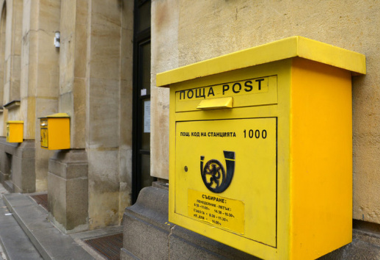
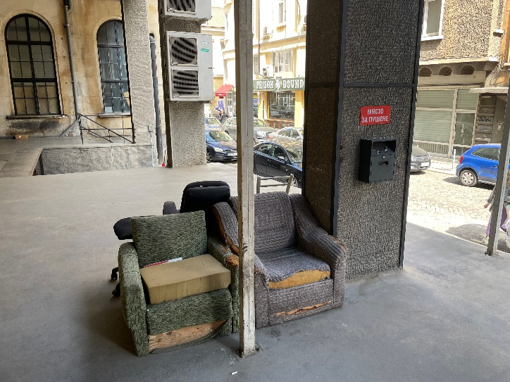
Bulgarian Post Crypto Attack
04-1
ICT Environment
2900+ Offices in 2700+ Settlements (cities & villages)
9000+ PCs with Average Age of 12 years (2300+ PCs with Windows XP SP3)
Mostly Centralized Server Infrastructure (Virtualized Servers & Lots of Terminal Servers)
Before the Attack
The hackers infiltrated the network a couple of weeks before the actual attack
Deployed variety of tools for distribution of malicious payloads within the network
During the Attack
Front-End
Vs.
Back-End
The crypto-virus was activated during the weekend before the campaign for distribution of Easter Pensions
Took six (6) hours to cut Internet access to servers and shutdown (at least) the backup servers
Aftermath
90+% loss of all databases, files, etc., including backups
Months of working “on paper” and restoring systems from scratch, re-entering data from paper, etc.
Post-Mortem Analysis
Forensic analysis showed that the deployed tools had been developed in Pascal
The crypto-virus had a “safety” logic and would not execute if Windows Regional settings are set to countries from the ex-USSR countries
No immediate proactive request for ransom, just the usual wallpaper with request for Bitcoins

Slide 12
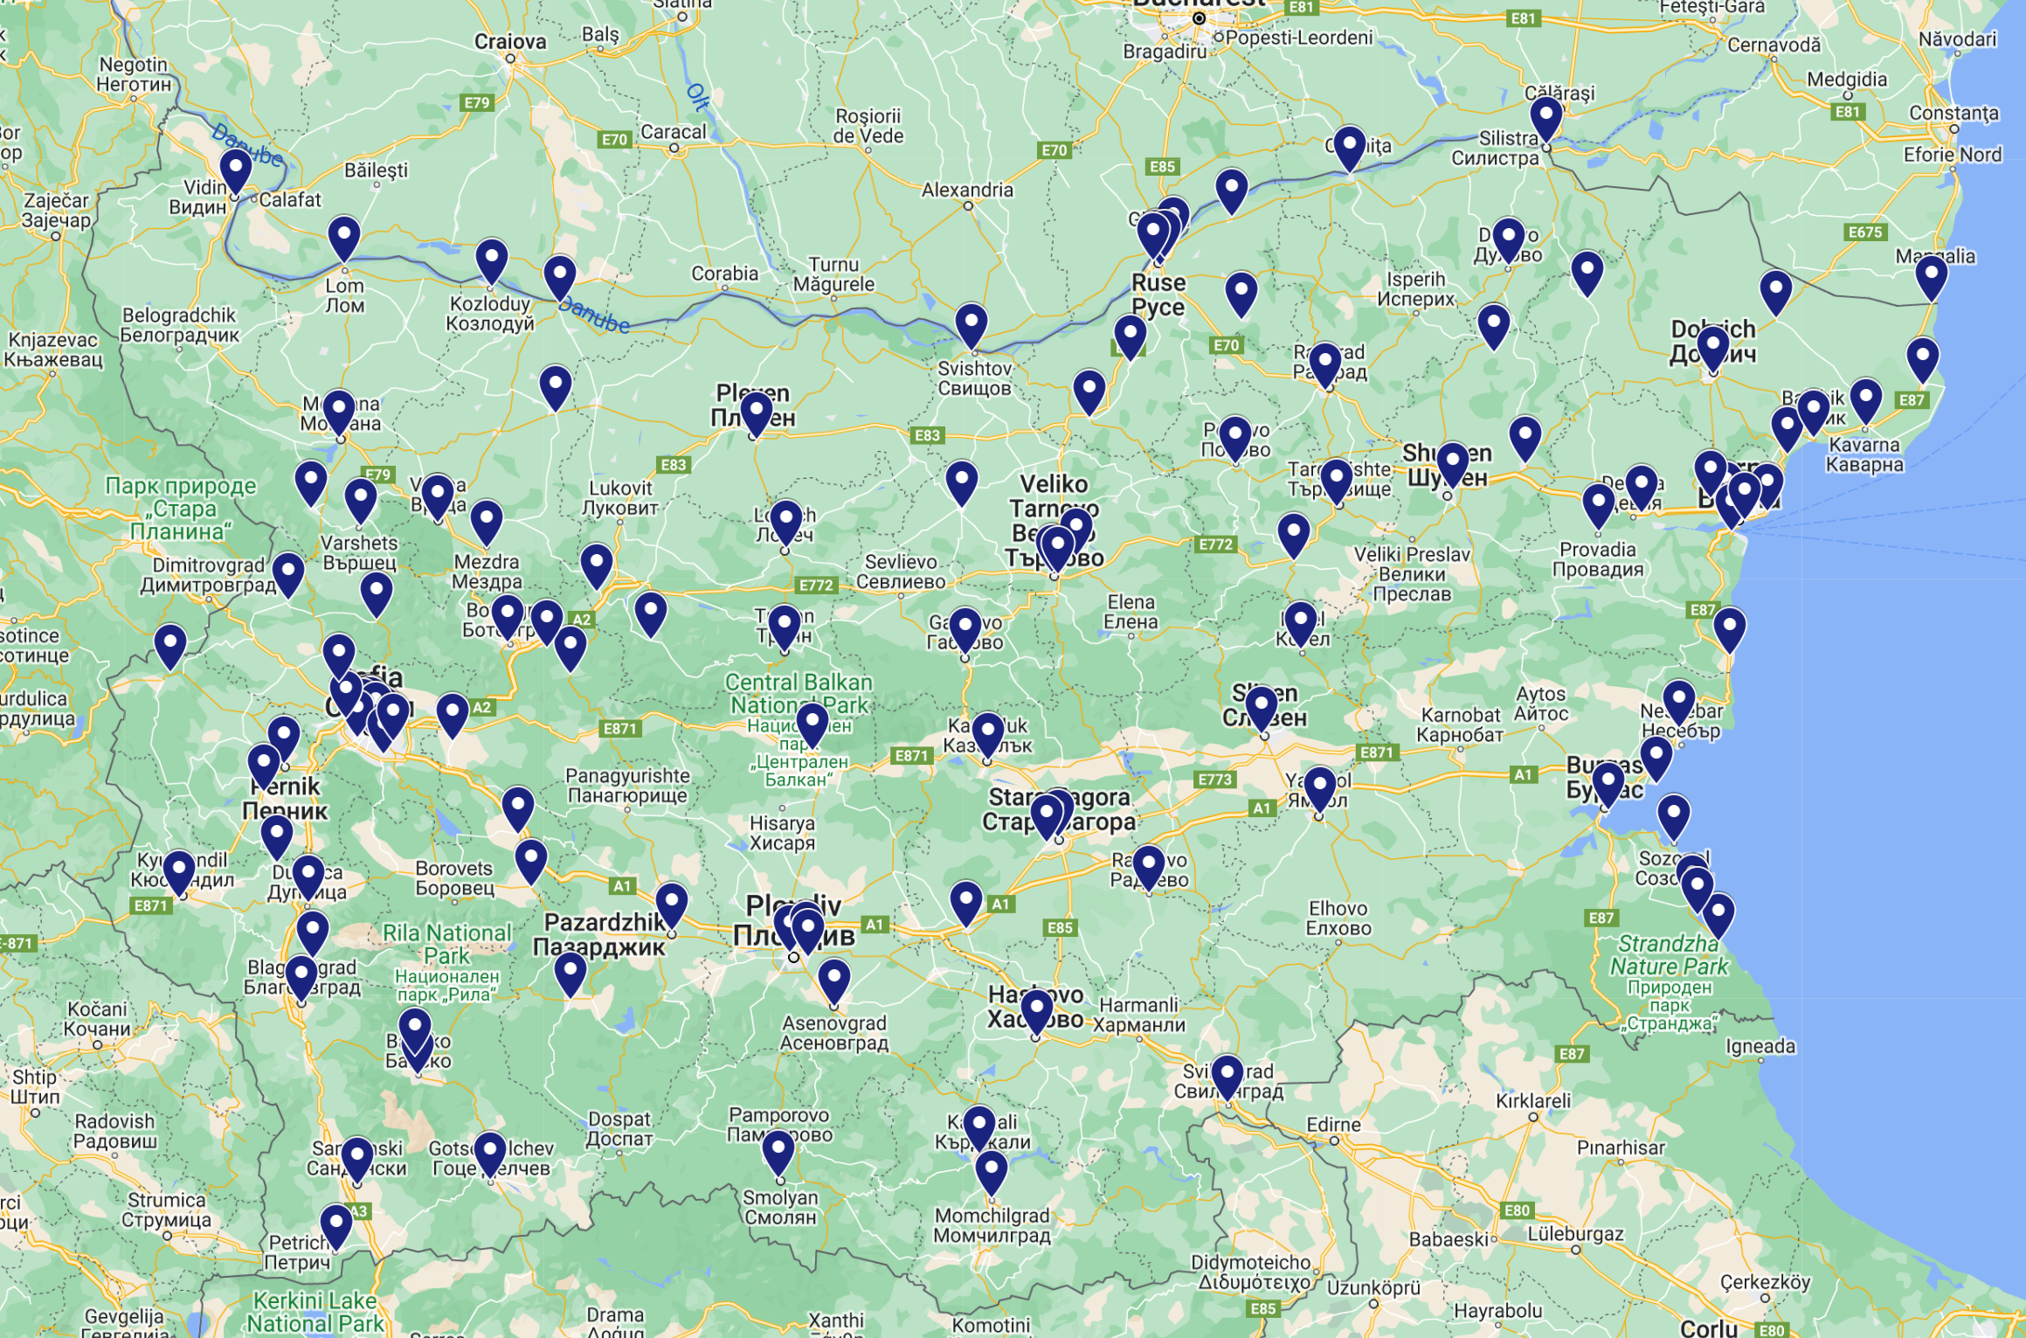

Stage Agency for Refugees Crypto Attack
05-1
ICT Environment
7+ Offices in 5 Locations (+ 100+ locations for registration for Temporary Protection)
200+ PCs for Administrative / Office Work + XX PCs in air-gapped network for refugees registration
Mostly Centralized Server Infrastructure (Virtualized Servers & Lots of Terminal Servers)
Before the Attack
Lots of publicity about the new registration process for Temporary Protection of persons displaced from Ukraine due to the Russian invasion
Deployment of hundreds of new registration workstations across the country (border points, resorts, regional & municipality centers)
Front-End
Vs.
Back-End
During the Attack
The crypto-virus was activated early in the morning
Took 15 minutes for the ICT team to shutdown infrastructure
Aftermath
Loss of document workflow system, mail-boxes and files on the file server (later restored from backup)
Refugees Registration System not compromised, no breach of the air-gapped network, no data leakage
Post-Mortem Analysis
Quick reaction is paramount
Security by-design if preferable than wishful thinking

Slide 13
Final-Thoughts & Conclusions

Slide 14
Questions & Answers

